Slide 1

Quantum Computing
Bhuvan Bezawada

Slide 2
Overview
Classical Computers
Quantum Computers
Quantum Code!

Slide 3

Classical Computers

Slide 4
A Computer
Back in the day
A person who makes calculations
Usually using some kind of calculating machine
These days
An electronic device
Receives data
Performs operations
Produces some kind of result

Slide 5
Old Computers. Like Really Old.
Difference Engine
1822, Completed in 2000
Colossus
1943
ENAIC
1946

Slide 6
Old Computers. Still Old.
TX0
1956
PDP - 1
1960
HP 9100 A
1968

Slide 7
Old Computers. A Little Old.
Altair 8800
1975
IBM 5100
1975
IBM PC
1981

Slide 8
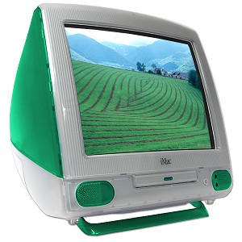
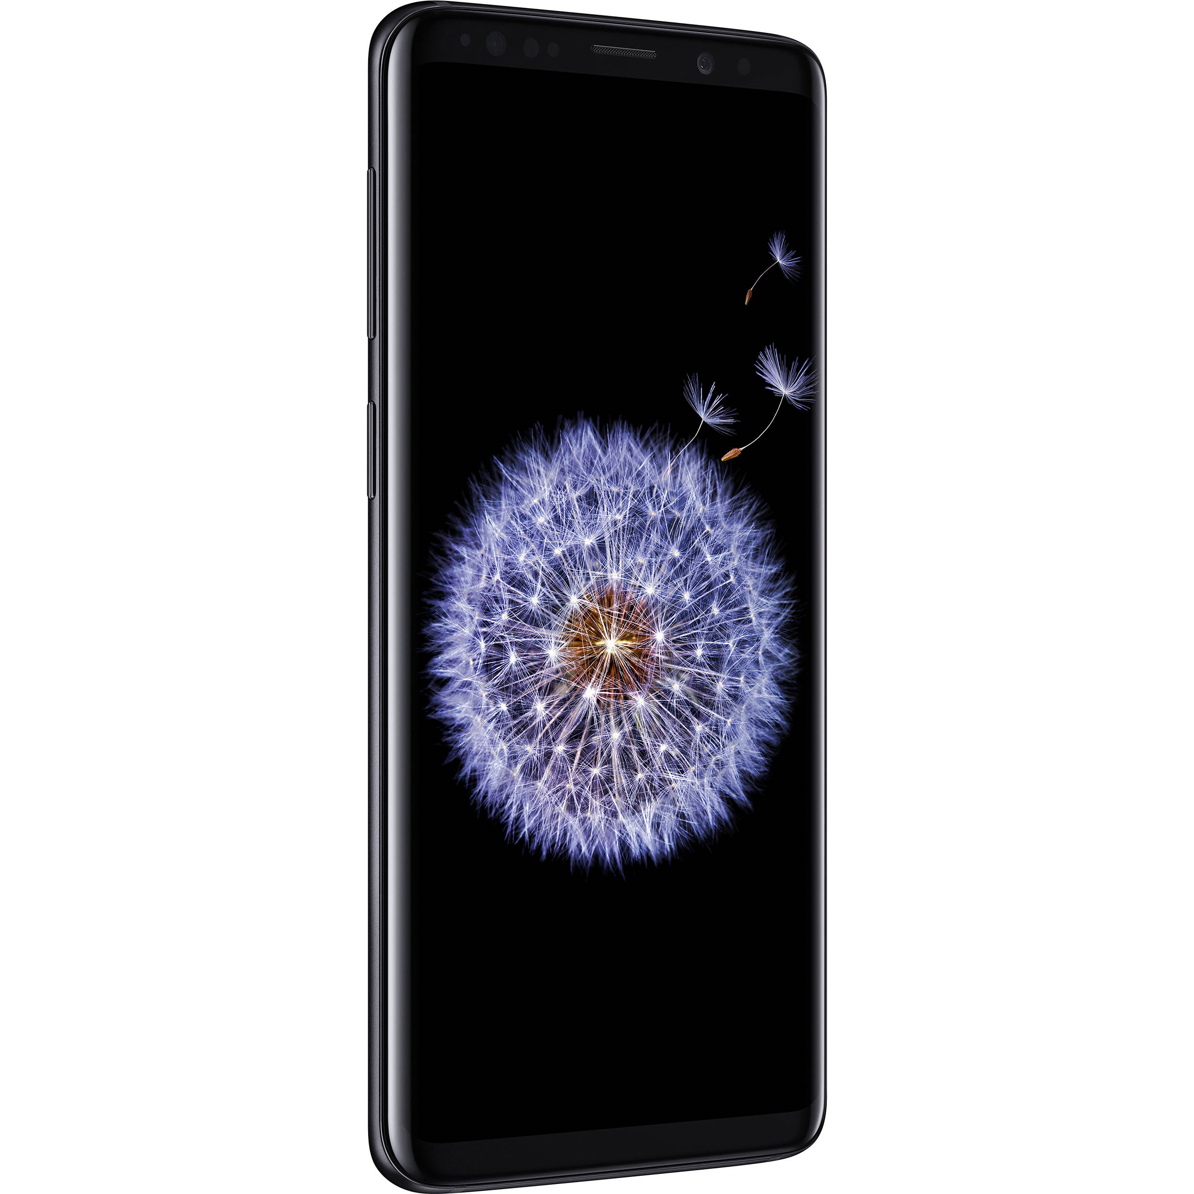
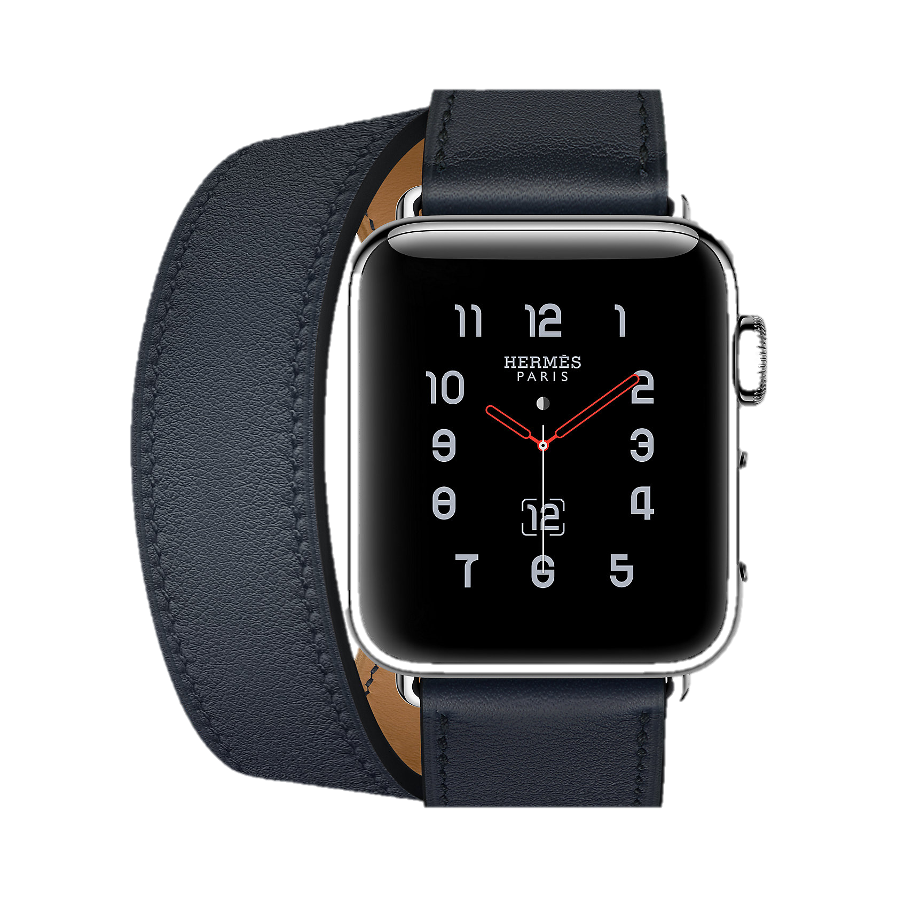
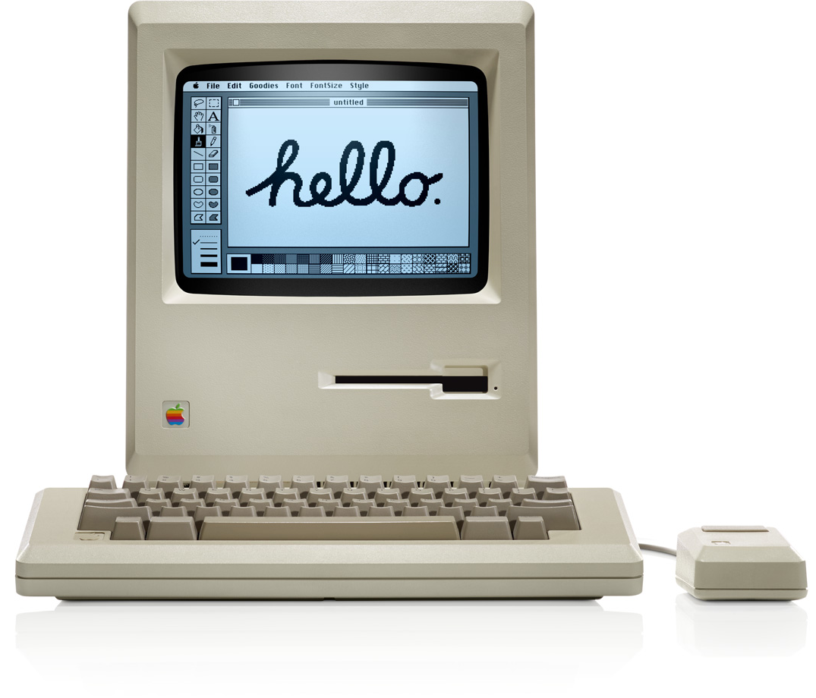
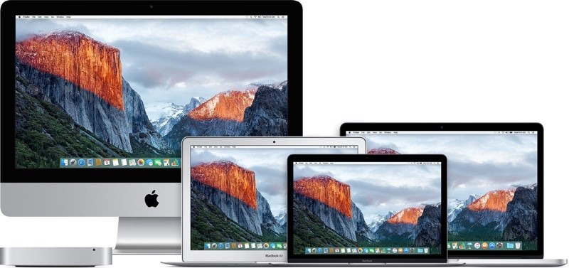
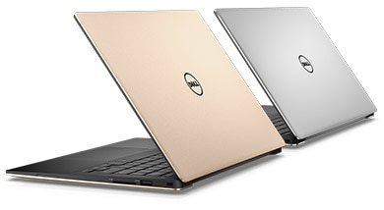
The Modern Computer
Apple Macintosh
1984

Slide 9
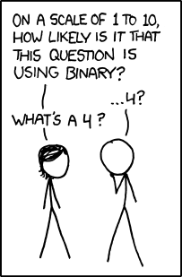
Classical Bits
Binary digits
Two states
0 (off)
1 (on)
0 1
https://xkcd.com/953/

Slide 10


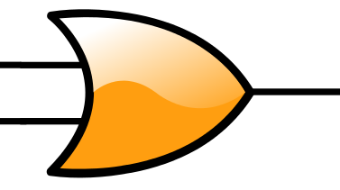
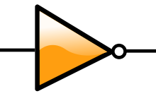
Logic Gates
AND
OR
NOT

Slide 11

Computer Modules
Combinations of logic gates
Adders
Multipliers
Put lots of modules together and you have a computer!

Slide 12

The Transistor
Electrical switch
Made from semiconducting materials
Used to build logic gates
Quite small in size

Slide 13
How Small?
Red blood cell
7 μm
HIV Virus
120 nm
Typical Transistor
14 nm

Slide 14
Motivation for Quantum Computers
Transistors are becoming really tiny
Too much heat produced by them
Silicon technology may collapse
Quantum tunnelling happens
Corrupts signals
Never an off state!
Need new way to enhance computing power
Needed to look beyond classical computers

Slide 15
Quantum Computers

Slide 16
A Quantum Computer
A machine that performs calculations
Based on the laws of quantum mechanics
Quantum mechanics
Behaviour of sub atomic particles
Uses qubits
Store information

Slide 17
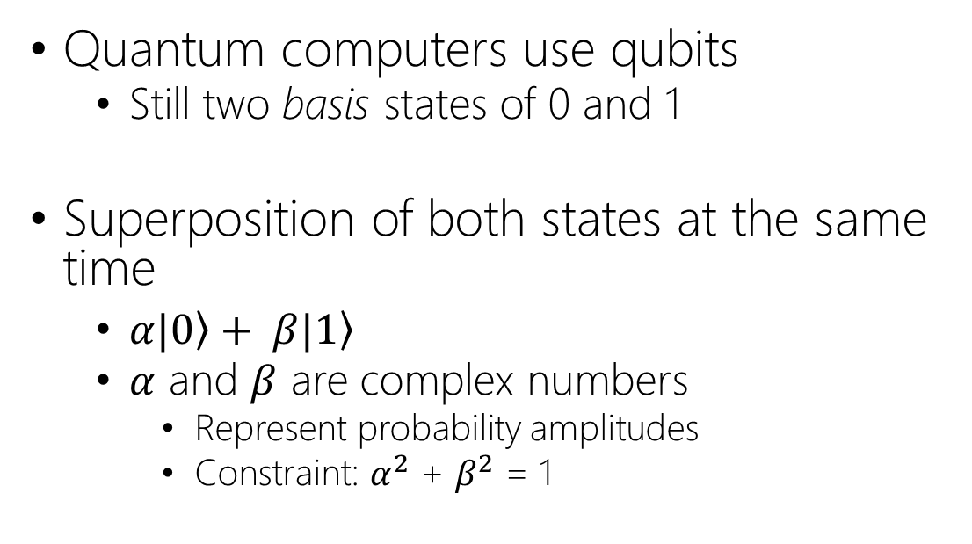
Qubits
Quantum computers use qubits
Still two basis states of 0 and 1
Superposition of both states at the same time
$α|\left.0\right\rangle + β|\left.1\right\rangle$
$α$ and $β$ are complex numbers
Represent probability amplitudes
Constraint: $α^{2}$ + $β^{2}$ = 1

Slide 18
A Physical Qubit
Implementation can be via
Atoms
Ionisation and ion traps
Electrons
Spin up and down
Photons
Polarisation horizontal/vertical

Slide 19

Quantum Information
N qubits can store 2^{N} binary numbers
So 2 qubits can store 4 binary numbers at the same time
Scope for parallel processing
But how do you know what it actually stores?
Superposition inherently means its not in any one state

Slide 20

Observation
Testing a value of qubit will make it take a state
Like opening Schrödinger's box
Observation tools
Depends heavily on type of qubit
Ion traps
Measurement of spin
Polarising filters

Slide 21

Caveat
You need extremely controlled environments
Generally have to be cooled to extremely low temperatures
Fault tolerance is important!
Need to do checks to ensure state
Qubits are really fragile so could change their ‘true’ state
Probability is used to determine the actual final state

Slide 22




Coherence
Coherent Superposition
A fundamental principle of quantum mechanics
Any 2 quantum states can be added together
Resulting state is also a valid quantum state
+
=

Slide 23

Decoherence
The more qubits in a quantum system the more susceptible it is to the influences of its external environment
If the system is not perfectly isolated coherence decays with time
Quantum behaviour is lost
Increases unpredictability
Not very useful!
+
≠

Slide 24
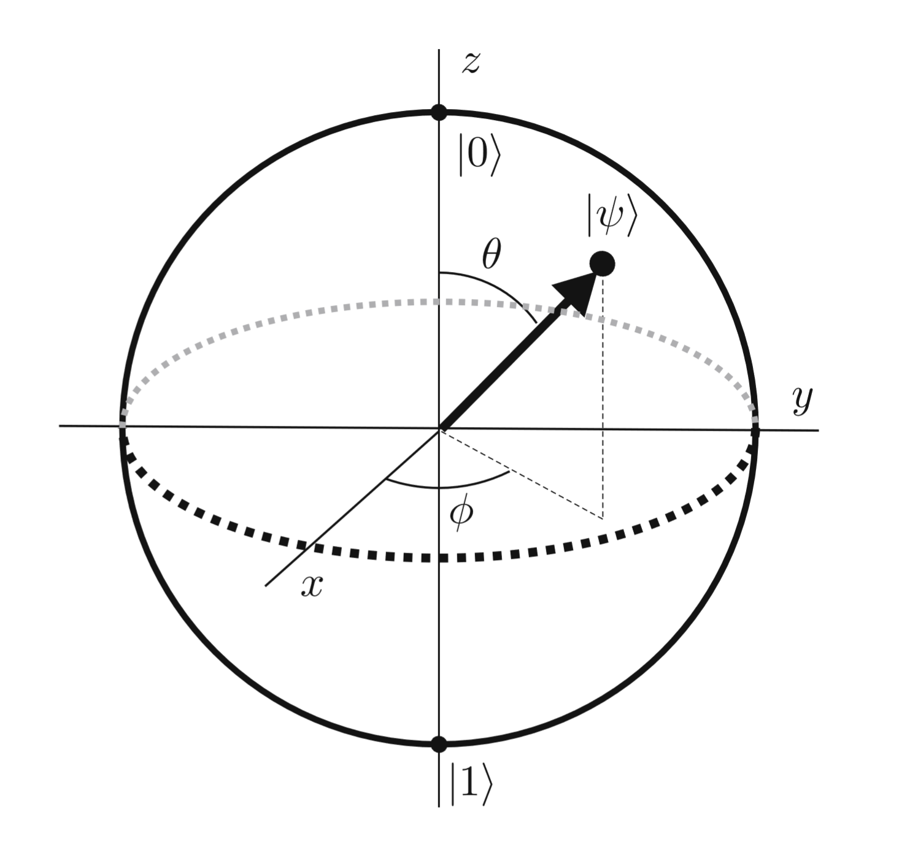
The Bloch Sphere
The state of a qubit can be described by a position on the sphere.

Slide 25

Entanglement
Observing one qubit can sometimes reveal an entanglement with one or more other qubits
Can use this property to deduce relationships between qubits

Slide 26
Quantum Gates
Qubit manipulation
Use microwaves
One superposition is input and another is the output
Similar to classical gates but key difference is that the input state can always be derived from the output state and vice versa.
Deterministic computation
Information is not lost

Slide 27
Quantum Gates
Hadamard gate
One qubit
Used to put qubit into superposition
Controlled Not Gate
Cnot gate
Similar to XOR gate

Slide 28

Uses
Encryption
Databases
Fast Processing Times

Slide 29

Shor’s Algorithm
Factorising massive numbers into primes is hard stuff
Basic principle
Show that a quantum computer can factorise big numbers in polynomial time
Concepts
Modular arithmetic
Quantum Parallelism
Quantum Fourier Transform

Slide 30
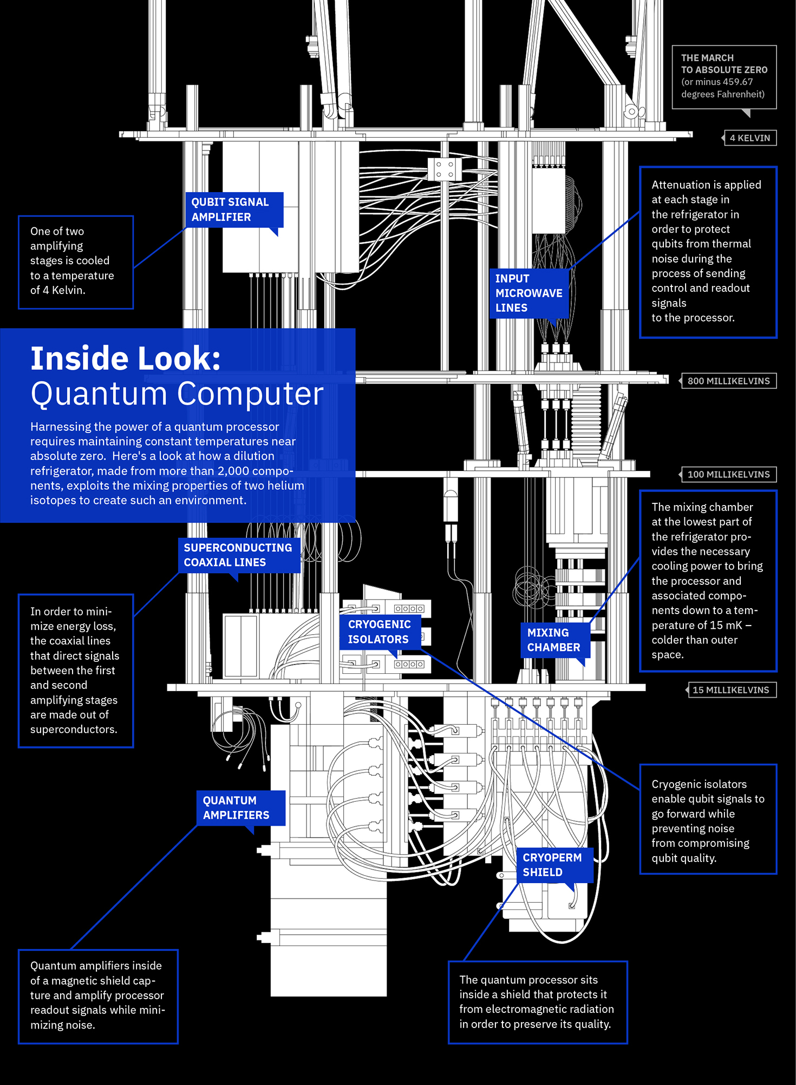

Slide 31
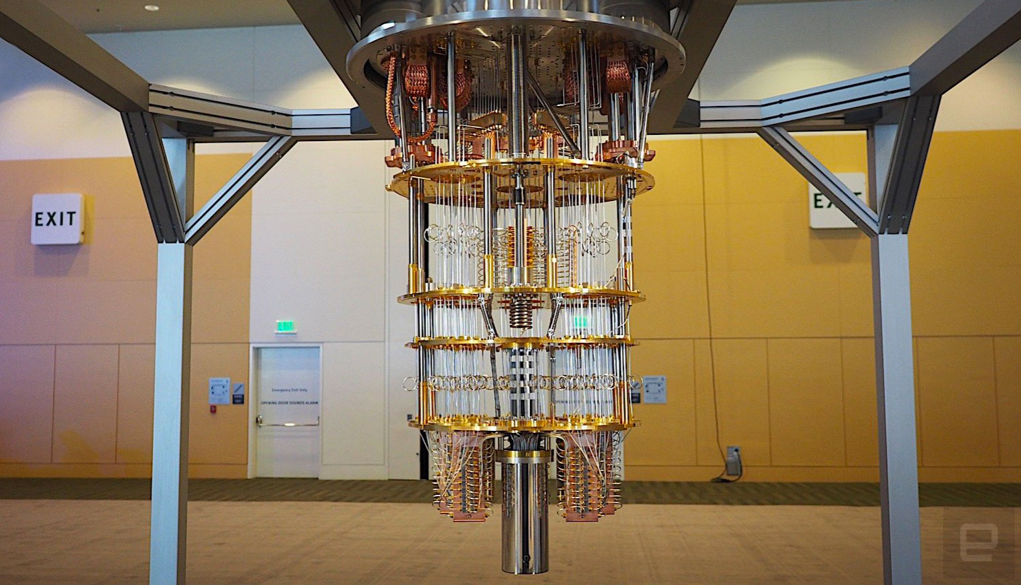

Slide 32
Research
72-qubit quantum processor
Quantum Simulation
Quantum Neural Networks
QuArC
Programming
IBM Q
Cloud Computing
QISKit

Slide 33


When Can I Get One?
Not really a PC
Currently very large and expensive
Can access one via the cloud on IBM

Slide 34

Quantum Code

Slide 35
Quantum Programming
Python
Qiskit
Q#
</>

Slide 36
Code Demo
</>

Slide 37
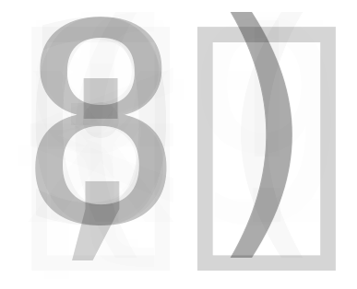
Result

Slide 38


Questions and Discussion

Slide 39
Thank You!

Slide 40
References
https://www.research.ibm.com/ibm-q/learn/what-is-quantum-computing/
http://vlsicad.eecs.umich.edu/BK/Slots/cache/www.eecs.umich.edu/~jhayes/JPH_DACslides_Jun03.pdf
https://github.com/Qiskit/qiskit-tutorial/blob/master/hello_world/quantum_emoticon.ipynb
https://www.youtube.com/watch?v=S52rxZG-zi0
https://www.youtube.com/watch?v=JhHMJCUmq28
All icons and images are from Google Images and Microsoft PowerPoint.
I do not own any of the graphics used.

